Slide 1


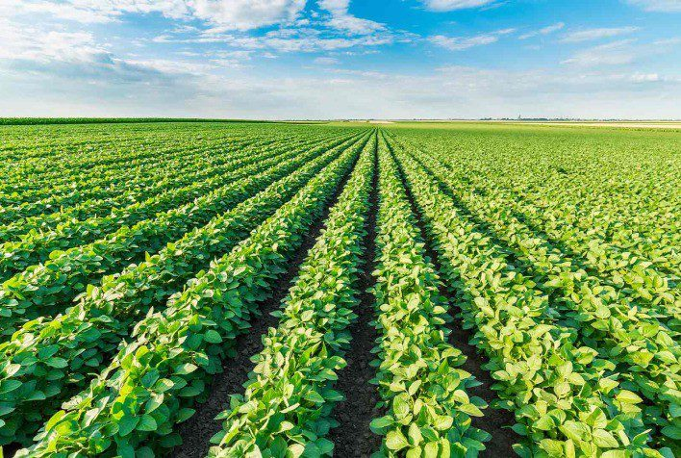
Data Challenge Phase 2
Prediction of soybean crop yields in Madhya Pradesh using machine learning

Slide 2

Table of contents
Introduction
Overview of the data
Feature selection analysis
Graphical Method
Advanced Method
Time series analysis
Graphical Method
Advanced Method

Slide 3
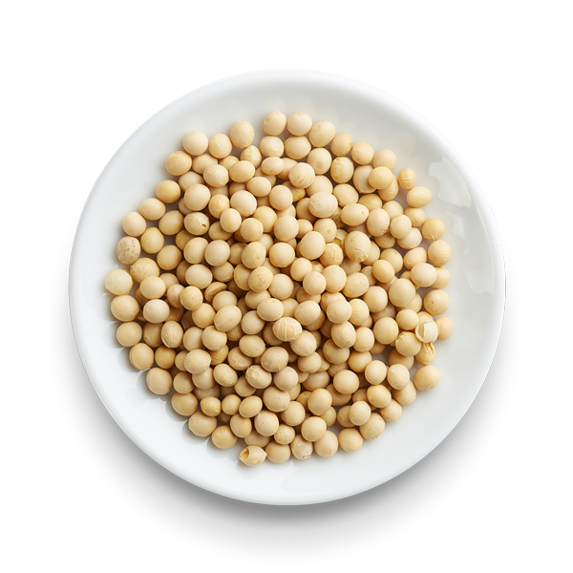

Introduction
The economy of Madhya Pradesh is an agrarian economy, which means that it is mainly based on the production and maintenance of crops and agricultural land. Agricultural yield is therefore a priority for its citizens who depend on it and especially the yield of soybean crops, the second most important crop in this state after wheat. In this sense, the prediction of soybean crops in Madhya Pradesh would be a real progress for agricultural management and farmers. So that is what we are going to do here using data and machine learning.

Slide 4
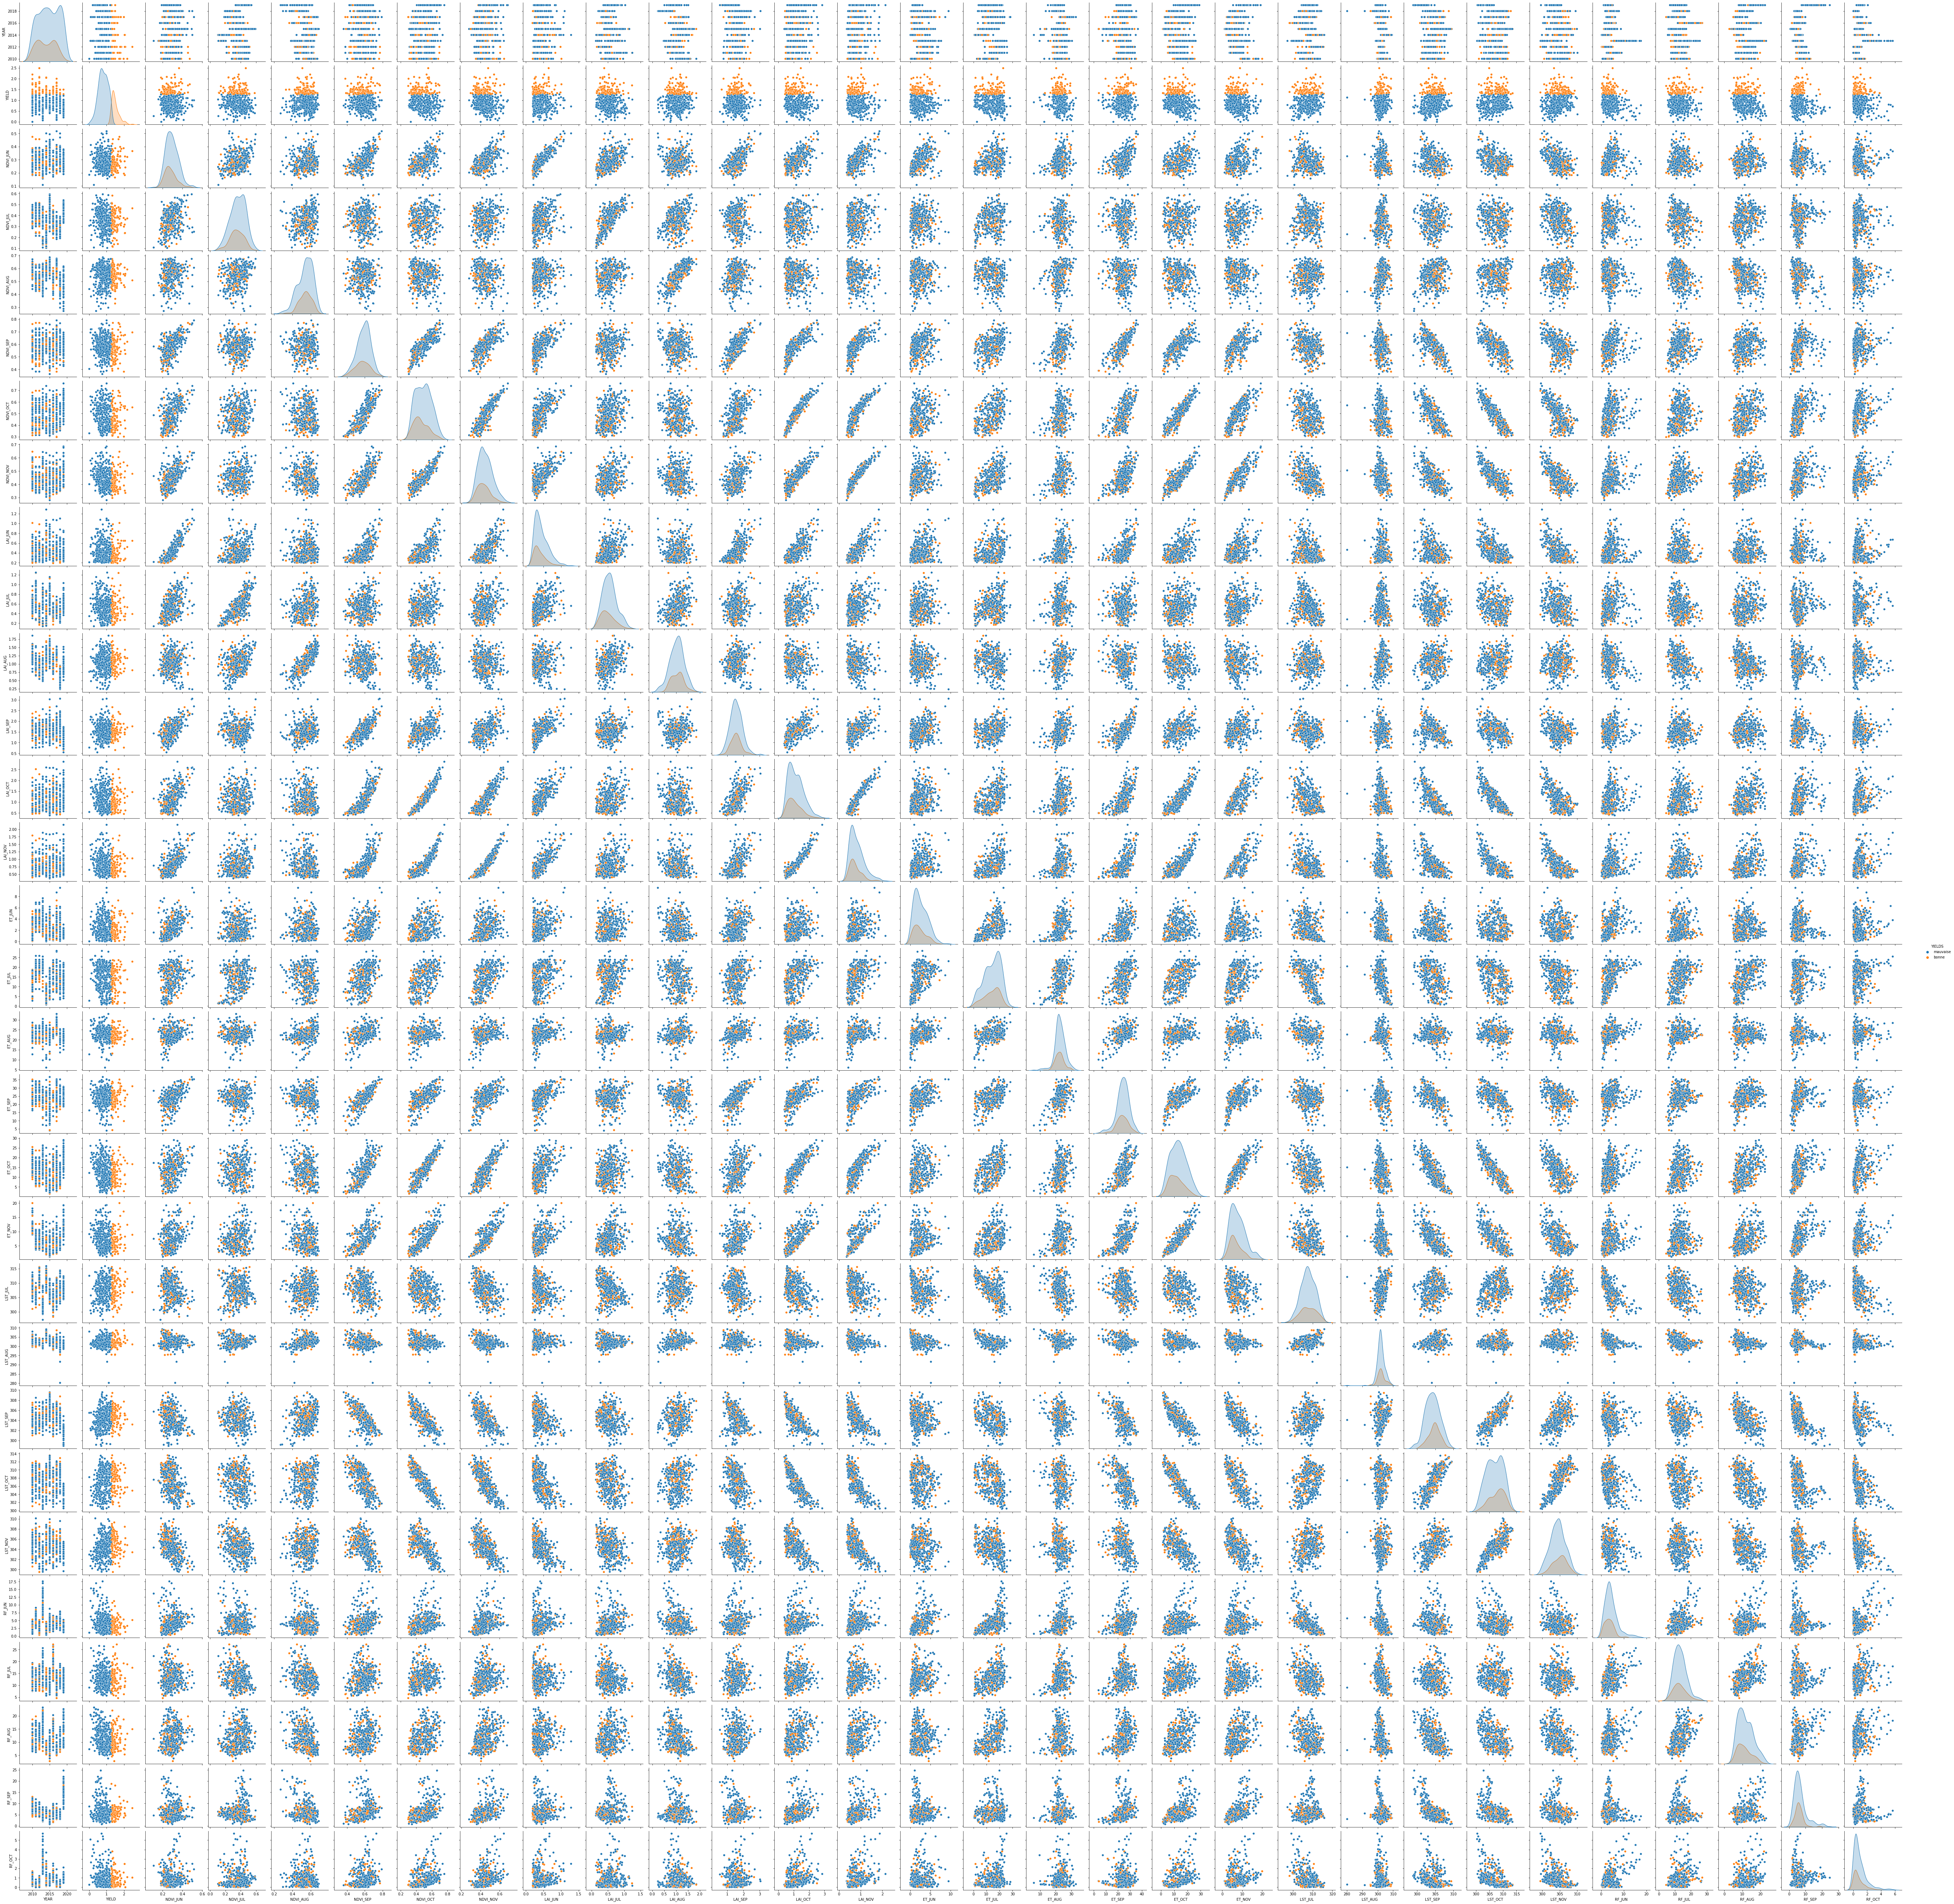
Overview of the data

Slide 5
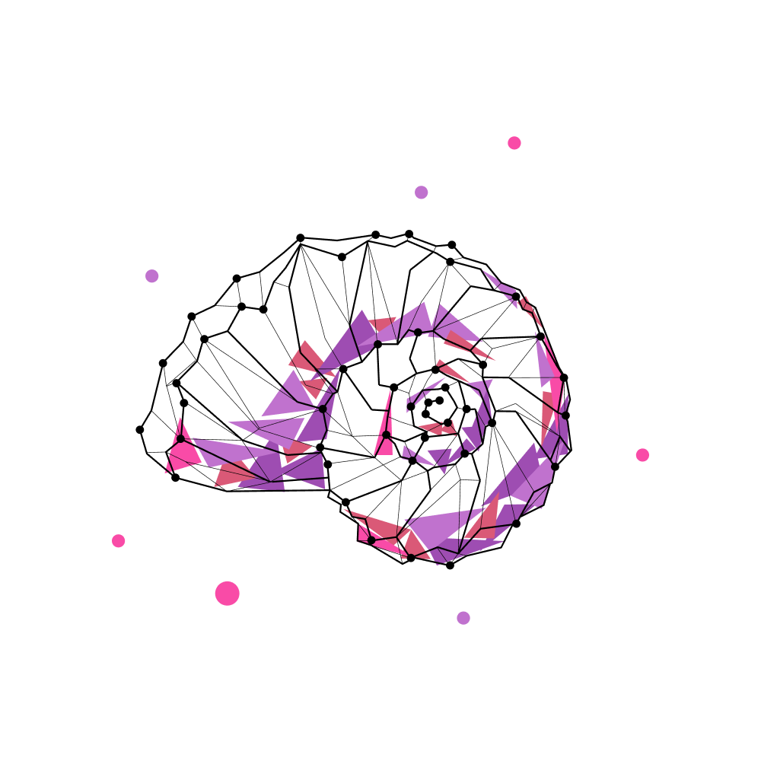
FEATURE SELECTION ANALYSIS
Sous-titre

Slide 6
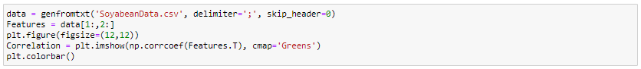
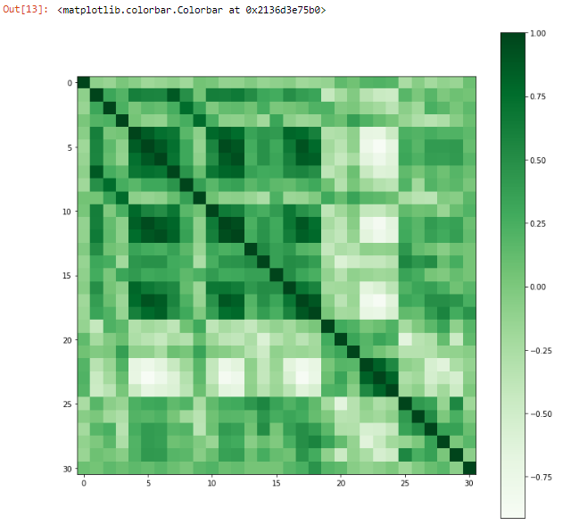
Correlation between numerical variables
Code :
Output :
We can observe a high correlation between some features of the dataset (e.g. : ). But what we are interested in here is the correlation between row 0 (the yields) and columns 1 to 30 (the features).

Slide 7
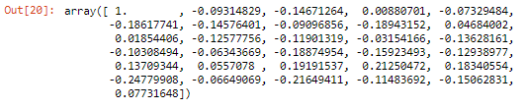
Ranking of variables based on their correlation
Code :
Output : Rank :
Note :
Rank | Index | Feature | Correlation
1 | 25 | RF_JUN | -0,24779908
2 | 27 | RF_AUG | -0,21649411
3 | 23 | LST_OCT | 0,21250472
4 | 22 | LST_SEP | 0,19191537
5 | 8 | LAI_JUL | -0,18943152
6 | 17 | ET_OCT | -0,18874954
7 | 5 | NDVI_OCT | -0,18617741
8 | 24 | LST_NOV | 0,18340554
9 | 18 | ET_NOV | -0,15923493
10 | 29 | RF_OCT | -0,15062831
11 | 2 | NDVI_JUL | -0,14671264
12 | 6 | NDVI_NOV | -0,14576401
13 | 20 | LST_JUL | 0,13709344
14 | 14 | ET_JUL | -0,13628161
15 | 19 | LST_JUN | -0,12938977
16 | 11 | LAI_OCT | -0,12577756
17 | 12 | LAI_NOV | -0,11901319
18 | 28 | RF_SEP | -0,11483692
19 | 15 | ET_AUG | -0,10308494
20 | 1 | NDVI_JUN | -0,09314829
21 | 7 | LAI_JUN | -0,09096856
22 | 30 | RF_NOV | 0,07731648
23 | 4 | NDVI_SEP | -0,07329484
24 | 26 | RF_JUL | -0,06649069
25 | 16 | ET_SEP | -0,06343669
26 | 21 | LST_AUG | 0,0557078
27 | 9 | LAI_AUG | 0,04684002
28 | 13 | ET_JUN | -0,03154166
29 | 10 | LAI_SEP | 0,01854406
30 | 3 | NDVI_AUG | 0,00880701
The ranking is based on the absolute value of the correlation between the target and the features because decorrelations are as important as correlations (an interesting feature is a feature that is farthest from 0, on the negative or positive side). Here, the feature that seems to be the most interesting for a linear model is the June rainfall feature which is however a decorrelation (the less it rains in June, the higher the yield).

Slide 8
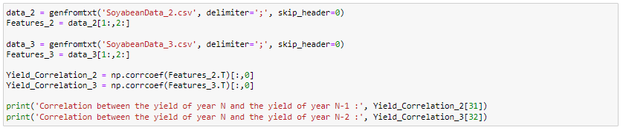
Correlation between the yield of year N and the yield of year N-1 / N-2
Code :
Output :
Note :
We notice that the correlation between the yields of years N and N-2 is strong and better than any other features.

Slide 9
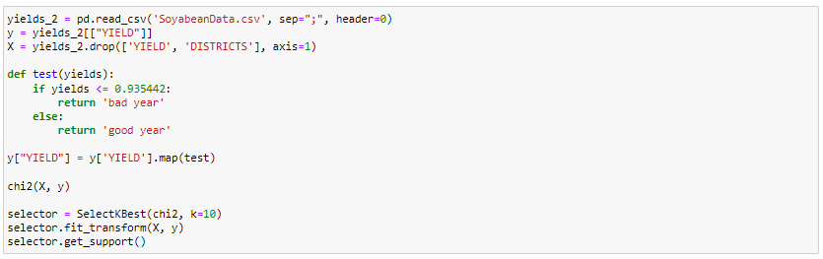
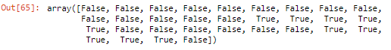
Feature selection : Advanced method 1 (chi square)
Code :
Output :
Features selected by Chi square : ET_JUL, ET_AUG, ET_SEP, ET_OCT, ET_NOV, RF_JUN, RF_JUL, RF_AUG, RF_SEP, RF_OCT

Slide 10

TIME SERIES ANALYSIS
Sous-titre

Slide 11
Yields vs time
Code :
Output :
We can observe a high correlation between some features of the dataset (). But what we are interested in here is the correlation between row 0 (the yields) and columns 1 to 30 (the features).

Slide 12
NDVI vs time
Code :
Output :
We can observe a high correlation between some features of the dataset (). But what we are interested in here is the correlation between row 0 (the yields) and columns 1 to 30 (the features).

Slide 13
LAI vs time
Code :
Output :
We can observe a high correlation between some features of the dataset (). But what we are interested in here is the correlation between row 0 (the yields) and columns 1 to 30 (the features).

Slide 14
ET vs time
Code :
Output :
We can observe a high correlation between some features of the dataset (). But what we are interested in here is the correlation between row 0 (the yields) and columns 1 to 30 (the features).

Slide 15
LST vs time
Code :
Output :
We can observe a high correlation between some features of the dataset (). But what we are interested in here is the correlation between row 0 (the yields) and columns 1 to 30 (the features).

Slide 16
RF vs time
Code :
Output :
We can observe a high correlation between some features of the dataset (). But what we are interested in here is the correlation between row 0 (the yields) and columns 1 to 30 (the features).

Slide 17
Selected model
K Nearest Neighbords
Code :

Slide 18
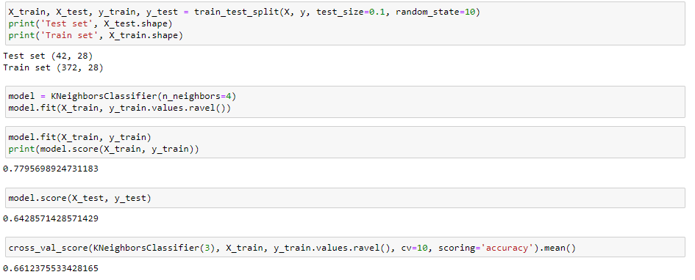
Cross validation
Code :

Slide 19
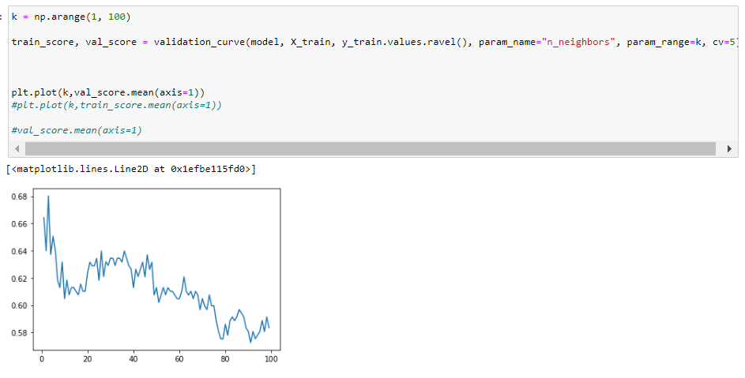
Validation Curve
Code :

Slide 20
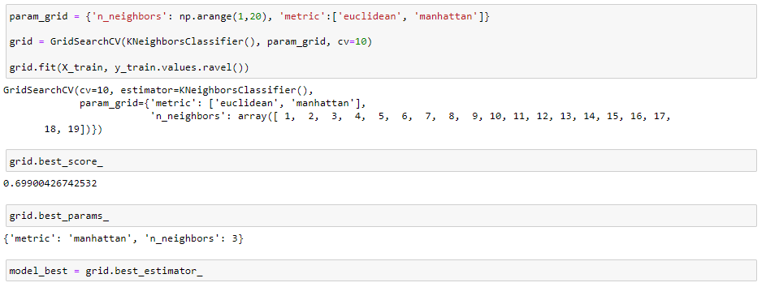
Hyperparameters selection using GridSearchCV
Code :

Slide 21
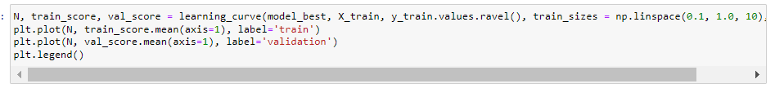
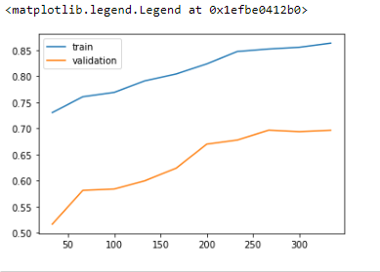
Learning Curve
Code :
Output :

Slide 22
Model’s accuracy
Code :

